Slide 1

CMR TECHNICAL CAMPUS Accredited by NBA, Approved by AICTE, affiliated to JNTUH Kandlakoya (V), Medchal Road, Hyderabad -501401
DEPARTMENT OF COMPUTER SCIENCE AND ENGINEERING
Morse code translator using eye blinks
Under the guidance
Mrs. G. Kavitha Reddy
Group Names
187R1A05C9(Sainath Cheparthy)
187R1A05E3(G.Srikar)
187R1A05E8(I.pranay goud)

Slide 2
CONTENTS
Abstract
Existing System
Disadvantages of existing system
Proposed System
Advantages of proposed system
Hardware Requirements
Software Requirements
Diagrams (LEL,REL)
Project Architecture
USECASE Diagram
CLASS Diagram
SEQUENCE Diagram
ACTIVITY Diagram
Conclusion

Slide 3
ABSTRACT
Morse code is a method used in telecommunication/communication to encode text characters as standardized sequences of two different signal durations, called dots and dashes, or dits and dahs.
Morse Code encodes the 26 Latin letters a through z, one non-Latin letter, the Arabic numerals, and a small set of punctuation and procedural signals (prosigns). There is no distinction between upper and lower case letters. Each Morse code symbol is formed by a sequence of dits and dahs. The dit duration is the basic unit of time measurement in Morse code transmission.
The duration of a dah is three times the duration of a dit. Each dit or dah within an encoded character is followed by a period of signal absence, called a space, equal to the dit duration. The letters of a word are separated by a space of duration equal to three dits, and words are separated by a space equal to seven dits.

Slide 4
EXISTING SYSTEM
The manual analysis of complex-natured, is fairly a time-consuming and tedious process, and could be prone to errors, For ages the morse code has been used by many government officials during emergencies and when the normal means of communication are not available, and it is also a type of sign language used by people to communicate.
We found some of the existing models like morse code translation using sound that works on the principle of sound clicks. In this method, the person will communicate with his eyes and another person need to convert it into sound (click) and that must be decoded into human-understandable language.
A few existing systems have devised different representations (or) data patterns of 0’s and 1’s to represent a character. In this model input is taken in form of eye blinks ,short blink means a dit , long blink means dah.

Slide 5
DISADVANTAGES OF EXISTING SYSTEM
Third party translators are needed
Time consuming
Error prone or accuracy

Slide 6
PROPOSED SYSTEM
In the proposed system we plan on using opencv, mediapipe to convert the morse code that is done by using different eye blinks into simple text , MediaPipe offers open source cross-platform, customizable ML solutions for live and streaming media.”, this definition is from their own website and explains what you can do with that library shortly and cleanly, they offer several other solutions that can run on different platforms and I’ll explain all of them in a different post in the future.
The feature that we’ll use today is called “Face Mesh”, this solution provides us a face landmark map with the most important 468 landmarks that can be seen in a human’s face.
Using that map we’ll calculate the ratio between some particular points in the face and with that information we’ll detect if the person on the camera blinked or not.
To be able to detect if an eye is blinked or not we use “ear” ratio which stands for “eye aspect ratio” to be able to calculate an eye’s “ear” value we need to access 6 landmarks at one’s face. The text is then converted to other regional languages along with text and speech.

Slide 7
ADVANTAGES OF PROPOSED SYSTEM
Reduces costs
Accurate
Time saving

Slide 8
HARDWARE REQUIREMENTS
For developing the application, the following are the Hardware Requirements:
Processor : intel i5 10th generation
RAM : 4GB
Hard Disk : 10GB
Input Device : Standard keyword and Mouse, HD webcam
Output Device : VGA and high resolution monitor, speaker

Slide 9
SOFTWARE REQUIREMENTS
Operating system : windows 10
Anaconda with python3
Spyder/Jupyter Notebook
Open cv
MediaPipe
gtts

Slide 10
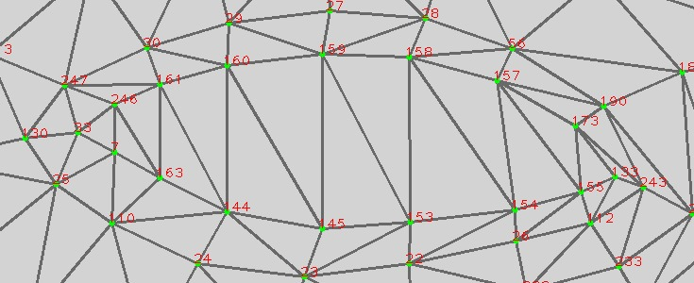
DIAGRAMS LEFT EYE LANDMARKS

Slide 11
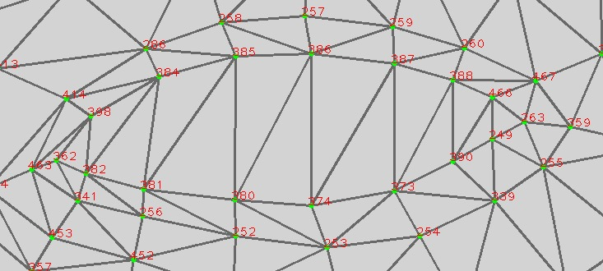
RIGHT EYE LANDMARKS

Slide 12
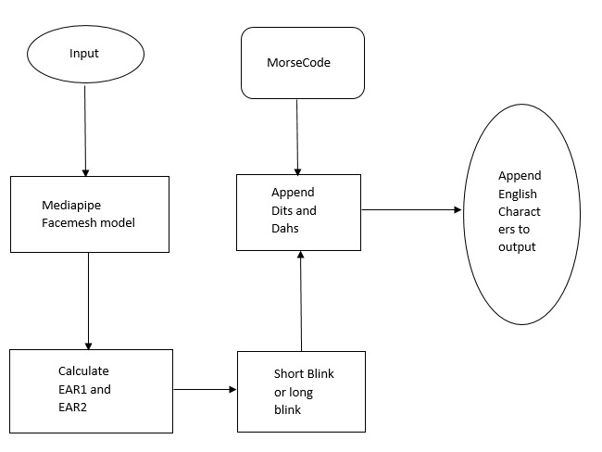
PROJECT ARCHITECTURE

Slide 13

MODULES DESCRIPTION
MODULE-1 (Input pre-processing)
Take input from a webcam or a video using opencv, convert the BGR input to RGB input, pass it to Media pipe Facemesh Model.
MODULE-2 (EAR calculation)
Mediapipe detects face and maps landmarks, calculate ear1 and ear 2 based on the landmarks, intialise count.

Slide 14
MODULE-3 (Dits or Dahs)
If count is 0 then add a value else if count==10 count=0, check ear 1 and ear2, if both of them are less than threshold value then its blink, based on fps find whether its a short blink or long blink, append the value to the string.
MODULE-4 (Speakable language)
If blinking stopped then, if there is character matching then append it to output word, array, and then convert it to the string, convert the string from English to any other language using gtts, print the output.

Slide 15
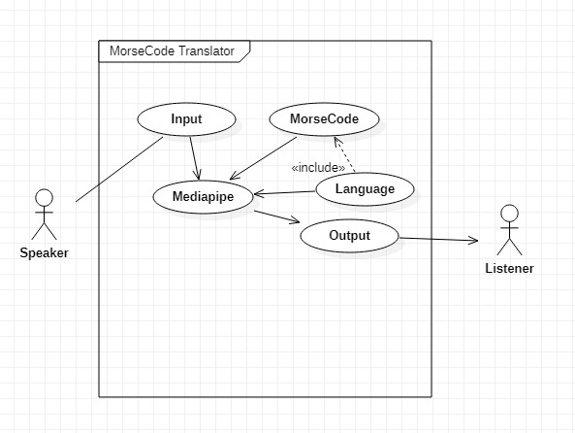
USE CASE DIAGRAM
Language(r)

Slide 16
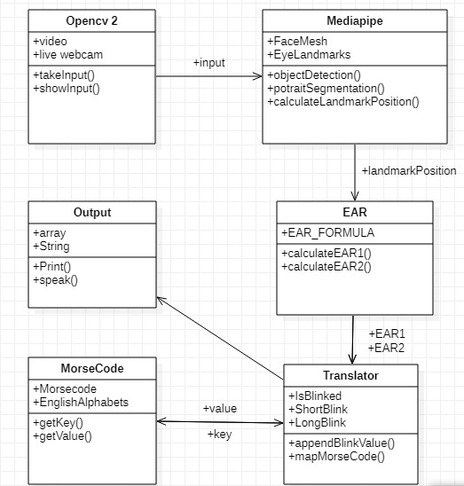
CLASS DIAGRAM
Language

Slide 17
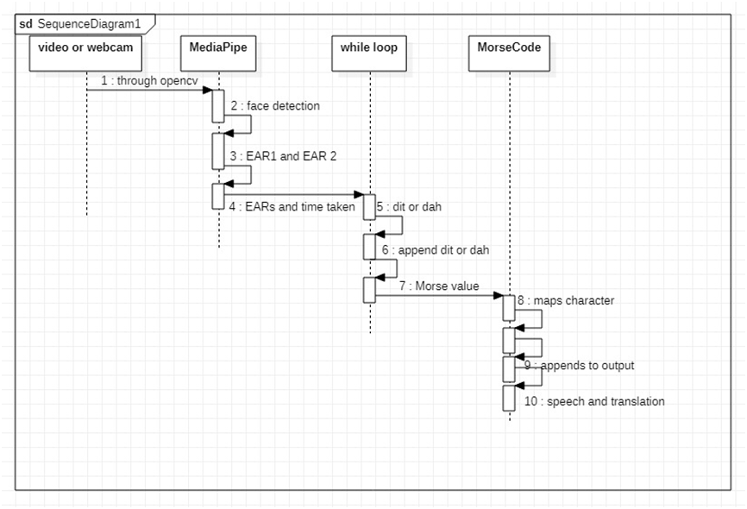
SEQUENCE DIAGRAM

Slide 18
SAMPLE CODE
import cv2
import mediapipe as mp
import time
def rescaleFrame( frame, percent=75): return cv2. resize(frame, dim, interlation =cv2.INTER_AREA)
width = int(frame.shape [1]* percent/ 100)
height = int(frame.shape [0] * percent/ 100)
dim = (width, height)
cap = cv2. VideoCapture (0)
pTime=0
mp_draw = mp.solutions.drawing_utils mp_facemesh = mp.solutions.face_mesh
facemesh=mp_facemesh. FaceMesh (max_num_faces=2) draw_spec=mp_draw.DrawingSpec (thickness=1, circle_radius=2)

Slide 19
ear1=abs((faceLm.landmark [160].x-faceLm.landmark[144].x)**2-(faceLm.landmark[160].y-faceLm.landmark [144].y)**2)+abs((faceLm.landmark[158].x-faceLm.landmark[153].x)**2-(faceLm.landmark[158].y-faceLm.landmark[153].y)**2 )/abs(((faceLm.landmark[33].x-faceLm.landmark[133].x)**2)-((faceLm.landmark[33].y-faceLm.landmark[133].y)**2))
ear2=abs((faceLm.landmark [385].x-faceLm.landmark[380].x)**2-(faceLm.landmark[385].y-faceLm.landmark [380].y)**2)+abs ((faceLm.landmark[387].x-faceLm.landmark[373].x)**2)-((faceLm.landmark[387].y-faceLm.landmark[373].y)**2 )/abs(((faceLm.landmark[362].x-faceLm.landmark[263].x)**2)-((faceLm.landmark[362].y-faceLm.landmark[263].y)**2))

Slide 20
if count>10: count=0
else:
count-count +1
if len(earlprev) >10: earlprev[count] = earl isLong = True
else:
earlprev.append(earl)
if len(ear2prev) >10: ear2prev[count] = ear2 1sLong-True
else:
ear2prev.append(ear2)

Slide 21
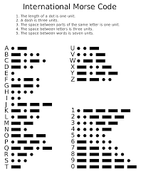

Slide 22
CONCLUSION
The existing system was quite complicated and people working on this system must have to remember a lot.
Whereas our system has resolved the complicated issues and added predictive power to it.
Here we translate not only with one language, we can translate to more regional languages and converting the generated text into the speech.

